Slide 1
Chapter 09
Knowledge Management Strategy and Planning

Slide 2
Objectives
Developing a Knowledge Management Strategy
Organizational Maturity Models
Gap Analysis
The KM Strategy Road Map
Balancing Innovation and Organizational Structure
Types of Knowledge Assets Produced
The Role of Leadership and Different KM Leadership Styles

Slide 3
Developing a Knowledge Management Strategy
The KM Strategy provides the basic building blocks used to achieve organizational learning and continuous improvement so as to not waste time repeating mistakes and so that everyone is aware of new and better ways of thinking and doing.

Slide 4
Developing a Knowledge Management Strategy
Sveiby (2001) developed a framework for categorizing the different types of KM initiatives. He uses three categories:
  External structure initiatives (e.g., gain knowledge from customers, offer customers additional knowledge).
  Internal structure initiatives (e.g., build a knowledge-sharing culture, create new-revenues from existing knowledge, capture the individual’s tacit knowledge, store it, spread it and reuse it and measure knowledge-creating processes and intangible assets produced).
  Competence initiatives (e.g., create careers based on KM, create microenvironments for knowledge transfer, and learn from simulations and pilot projects).

Slide 5
Developing a Knowledge Management Strategy
KM Strategy: A number of different types of business needs may trigger the need for KM :
  Imminent retirement of key personnel
  Need for innovation to compete in dynamic, challenging business environment
  Need for internal efficiencies in order to reduce cost and effort (e.g. time to market a new product)

Slide 6
Developing a Knowledge Management Strategy
Knowledge Audit
A knowledge audit service identifies the core information and knowledge needs and uses in an organization. It also identifies gaps, duplications, and flows and how they contribute to business goals.
A knowledge inventory (sometimes called an information audit or a knowledge map) is a practical way of coming to grips with “knowing what you know.” This inventory is usually performed by applying the principles of information resources management (IRM)

Slide 7
Developing a Knowledge Management Strategy
Knowledge Audit
A knowledge audit can produce the following types of results:
  Identification of core knowledge assets and flows – who creates, who uses.
  Identification of gaps in information and knowledge needed to manage the business effectively.
  Areas of information policy and ownership that need improving.
  Opportunities to reduce information-handling costs.
  Opportunities to improve coordination and access to commonly needed information/
  A clearer understanding of the contribution of knowledge to business results.

Slide 8
Organizational Maturity Models
Another type of knowledge audit looks at the overall maturity level or organizational readiness for KM.
The notion of an optimal point or a threshold point that should be reached before effective knowledge management can be implemented is inherent in a number of organizational, KM, and community maturity models.
Maturity models have their roots in software engineering.

Slide 9
Organizational Maturity Models
A maturity model: “a descriptive model of the stages through which organizations progress as they define, implement, evolve, and improve their processes.
This model serves a guide for selecting process improvement strategies by facilitating the determination of the current process capabilities and the identification of issues most critical to quality and process improvement within a particular domain, such as software engineering or systems engineering”
There are a number of organizational and KM maturity models, most derived from the Capability Maturity Model, CMM

Slide 10
Organizational Maturity Models
The five stages of the CMM are:
  1. Initial: Processes are ad-hoc, chaotic, or not well defined.
  2. Repeatable: Basic processes are established and there is a level of discipline to stick to these processes.
  3. Defined: All processes are defined, documented, standardized, and integrated into each other.
  4. Managed: Processes are measured by collecting detailed data on the processes and their quality.
  5. Optimizing: Continuous process improvement is adopted and in place by quantitative feedback and from piloting new ideas and technologies.

Slide 11
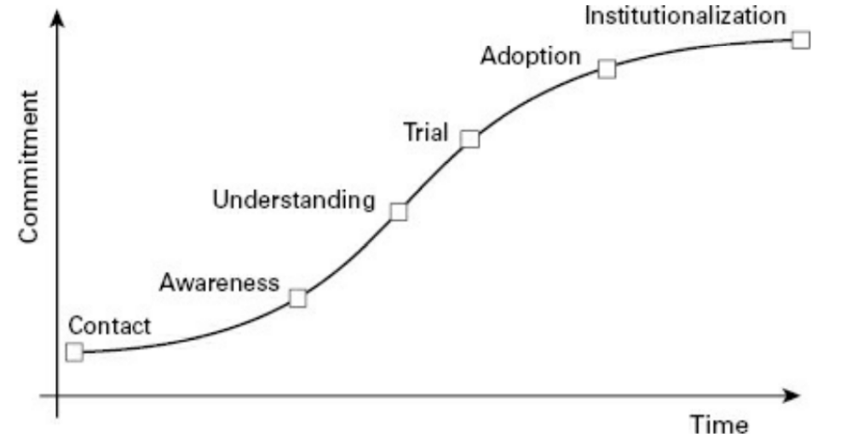
Organizational Maturity Models

Slide 12
Organizational Maturity Models
Stages of organizational maturity
  Chaotic:
    Noncohesive culture
    Decision making in-flight
    Leadership structure vague
    Operation model undefined
    Employees evaporating

Slide 13
Organizational Maturity Models
Stages of organizational maturity
  Ad hoc:
    Multiple local cultures, leadership structures, and operation models
    Local decision making
    Employee turnover high except in preferred classes of employees

Slide 14
Organizational Maturity Models
Stages of organizational maturity
  Organized:
    Similar local cultures
    Local decision making based on corporate strategy
    Local leadership linked to corporate leadership team
    Corporate operation model pushed down to local level
    Stable employee base

Slide 15
Organizational Maturity Models
Stages of organizational maturity
  Managed:
    Cohesive corporate culture and operation model
    Corporate strategy drives operational tactics
    Corporate leadership team coaches and empowers local leaders
    Employees recruited and retained based on strategic direction

Slide 16
Organizational Maturity Models
Stages of organizational maturity
  Agile:
    Culture adapts strategically
    Operation model changes dynamically based on environmental changes
    Professionals compete to work for corporation

Slide 17
Organizational Maturity Models
KM Maturity Model
  Paulzen and Perc (2002) have proposed a knowledge process quality mode (KPQM) based on the major tenets of quality management and process engineering.
  The authors make the assumption that since software development is a knowledge-based activity, it is valid to adapt these models for KM.

Slide 18
Organizational Maturity Models
KM Maturity Model
  The Forrester Group KM maturity model describes the different stages of maturity in terms of how people are supported throughout the KM Cycle.
  This model is quite useful in determining the level of knowledge support that will be needed for effective KM to be established within a given organization.

Slide 19
Organizational Maturity Models
CoP Maturity Model
  Maturity models have also been applied to the CoP life cycle.
  A CoP maturity model can serve as a good road map to show what steps need to be taken to move communities to the next stage.

Slide 20
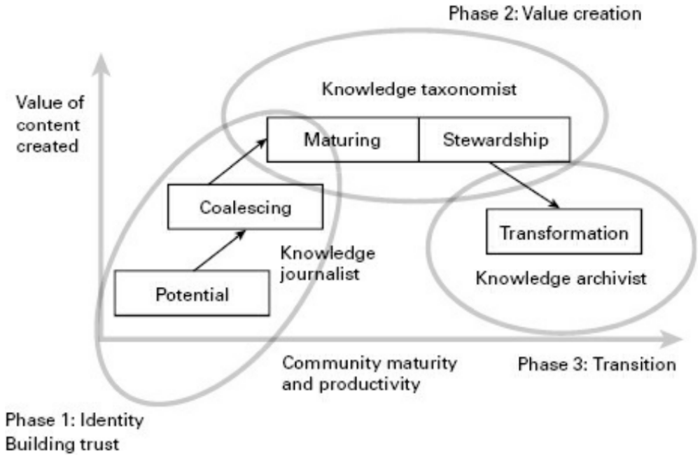
Organizational Maturity Models
CoP Maturity Model:

Slide 21
Organizational Maturity Models
CoP Maturity Model:
Major features of six maturity models
  1. Paulk organizational maturity: Represents the adoption of a new technology or process within an organization, which is a very good match for the introduction of new KM functions.
  2. Fujitsu organizational maturity: Provides a fast and easy way of assessing how cohesive or pervasive a culture is within a given organization.
  3. Infosys KM: A model that is much more specific and allows diagnosis of specific KM behaviors

Slide 22
Organizational Maturity Models
CoP Maturity Model:
Major features of six maturity models
  4. Paulzen and Perc KPQM: The KPQM is quite similar to the Infosys KM model and also allows for incremental introduction of KM initiatives into an organization based on the phase of KM maturity.
  5. Forrester Group KM maturity model: A model that focuses on how employees acquire relevant content that is particularly well suited for an incremental introduction of knowledge support services within an organization.

Slide 23
Organizational Maturity Models
CoP Maturity Model:
Major features of six maturity models
  6. Wenger CoP lifecycle model: The CoP lifecycle model can also provide a good indicator of the cultural evolution of an organization, particularly as it pertains to the coalescing of informal networks of peers who regularly share valuable knowledge with one another. The CoP lifecycle model can also help identify key KM roles and responsibilities that should be introduced at each phase.

Slide 24
Gap Analysis
The difference between the organization’s existing and desired KM state is analyzed in terms of enablers and barriers to successful KM implementation.

Slide 25
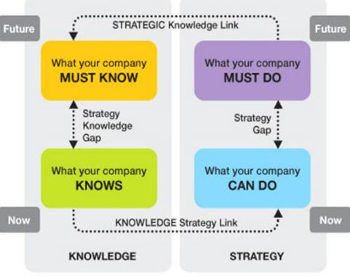
Gap Analysis
The strategic gap analysis

Slide 26
Gap Analysis
A good gap analysis should address the following points (Zack, 1999; Skyrme, 2001):
  1. What are the major differences between the current and desired KM states of the organization?
  2. List barriers to KM implementation
  3. List KM leverage points or enablers
  4. Identify opportunities to collaborate with other business initiatives

Slide 27
Gap Analysis
A good gap analysis should address the following points (Zack, 1999; Skyrme, 2001):
  5. Conduct a risk analysis
  6. Are there redundancies within the organization?
  7. Are there knowledge silos?
  8. How does the organization rank with respect to others within the industry?

Slide 28
Gap Analysis
The result will be a KM strategy document that can be used as road map to implement short-term KM initiatives within the organization (those with the highest scores on feasibility, cost-benefit, and priority) as well as a longer-term KM strategy that will describe some of the longer, more complex initiatives.

Slide 29
The KM Strategy Road Map
The final recommended strategy would typically cover a three to five year period, outlining the key priorities for each year. The road map addresses issues such as:
  1. How will the organization manage its knowledge better for the benefits of the business?
  2. Content (management of explicit knowledge) and community (management of tacit knowledge) priorities.

Slide 30
The KM Strategy Road Map
The final recommended strategy would typically cover a three to five year period, outlining the key priorities for each year. The road map addresses issues such as:
  3. Identification of process, people, products, services, organizational memory, relationships, knowledge assets as high priority knowledge levers to focus on.
  4. What is the clear or direct link between KM levers and business objectives?
  5. What are some quick win?
  6. How will KM capability be sustained over the long term?

Slide 31
Balancing Innovation and Organizational Structure
A balance between innovation and organizational structure should be the desired outcome of a good KM strategy.
If the organization is too fluid, there will be no solid connection of knowledge work to business goals, and it will be difficult to have clear accountability.
If the balance shifts too much in favor of institutionalization, however the organization risks becoming too formal, which can stifle innovation and the open communication necessary for creative work to take place

Slide 32
Types of Knowledge Assets Produced
Edvisson and Malone (1997) propose that knowledge assets can be laced in one of these categories:
  1.Human capital, or all the brainpower that “leaves at 5 PM.”
  2.Structural capital, or all the brainpower that “stays after 5 PM” (policies, procedures, training courses, patents, etc).
  3.Customer capital, or all the corporate relationships with customers and prospects.

Slide 33
The Role of Leadership and Different KM Leadership Styles
Leadership plays
  Helps determine the types of interactions that will take place, including knowledge-sharing interactions.
  Helps shape the culture and plays a key role in establishing incentives and disincentives for organizational behaviors.

Slide 34
The Role of Leadership and Different KM Leadership Styles
Donate and de Pablo (2015) note that a new type of leadership, called knowledge-oriented leadership, may be required in order to address the two major goals of KM: efficiency and innovation.
Knowledge-oriented leadership is a leadership style that includes all the major KM processes: leaders play an active role in knowledge creation, sharing, dissemination, preservation, and application.
A final component is that KM leadership include not only a tolerance of errors, but of risk taking, admitting errors, and being allowed to learn and improve. This type of leadership is much more likely to lead to both efficiency gains and innovative results.

Slide 35
Summary
The key steps in the evolution of an innovative new idea and the institutionalization of a best practice that forms the object of reuse.
The major strengths and weaknesses of different maturity models in terms of how they can be used to assess progress toward KM goals.

Slide 36
Summary (con’t)
The different approaches that may be undertaken in order to achieve an optimal balance between creativity and organizational structure.
The different types of knowledge assets that result from KM initiatives.
The major phases involved in initiating organizational change and review how the organizational culture would have to evolve so that KM goals can be attained.

Slide 37

Discussion / Homework / Team Activities
Compare and contrast KM applications that are driven by an objective of reuse ersus and innovation.
What are some of the pros and cons of a web-based questionnaire versus face-to-face interviewing when conducting a knowledge audit?
What are some of the maturity models that can be used to situate a company with respect to its KM culture?
What are the major differences between the short-term and long-term strategies? How do they fit together?
List and provide examples for some different types of knowledge assets. What are some typologies that can be used to categorize them?
What is the relationship among human, structural, and relationship capital?

